Slide 1

Survive and
Thrive with
Trust Act 25!
Jocelyn Borowsky
Duane Morris LLP
Greg Weinig
Connolly Gallagher LLP

Slide 2
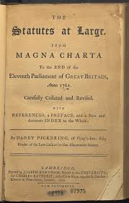


2025 Statutes
Trust Act 2025
Parentage amendments
Transfer on Death Deeds

Slide 3
Trust Act 2025: Four Themes this Year
Exercise of Discretion (section 3315)
Purpose Trusts (section 3556, et al.)
Resignation of Officeholders (section 3326)
Gifts Between Spouses (Title 13, section 1513)

Slide 4
Exercise of Discretion
(Section 3315)
Recall that Section 3315 currently provides:
  Subsection (a): under Delaware law, a Trustee’s exercise of discretion is governed by Restatement of Trusts (Second) section 187 (not by Restatement of Trusts (Third) sections 50 and 60)
  Subsection (b): heavily curtails the ability of a beneficiary of a discretionary trust to compel a distribution
  Subsection (c): rules regarding letters of wishes (see Trust Act 2024)

Slide 5
Exercise of Discretion – 3315 subsection (b) already provided (before TA 2025):
  A beneficiary eligible for distributions has a discretionary interest.
  Discretionary interest = “mere expectancy, not a property right”
  Previous point applies even if subject to ascertainable standard
  Even (seemingly mandatory) language such as “shall” still creates a discretionary interest if qualified by discretionary distribution language

Slide 6

Despite all that, at least one commentator thought ……

Slide 7
Exercise of Discretion – cont’d
….. that the pre-TA 2025 language of Section 3315 wasn’t as clear as language in its predecessor (former subsection (f) of Section 3536), which stated:
“A discretionary interest is neither a property interest nor an enforceable right – it is a mere expectancy” (emphasis ours).

Slide 8
Exercise of Discretion – cont’d
Though we respectfully disagree, for the sake of crystal clarity, we:
Added to subsection (b) the sentence “A beneficiary that has a discretionary interest in a trust shall not be deemed to have a right to compel a distribution from the trust.”
Moved the sentence stating that it does not alter subsection (a)’s standard of review from the end of (b) to follow this new sentence.

Slide 9
Exercise of Discretion – cont’d
So now the middle section of 3315(b) reads:
“A beneficiary that has a discretionary interest in a trust shall not be deemed to have a right to compel a distribution from the trust. Nothing within this subsection, however, shall be deemed to alter the standard of review of the discretion of the fiduciary under subsection (a) of this section.”

Slide 10

Exercise of Discretion – cont’d
Q. Why not clone the previous “not an enforceable right” language?
A. Oversimplification of trust law – if fiduciary’s discretion is unreviewable, is it still a trust?

Slide 11


Purpose Trusts
(Section 3556 et al.)

Slide 12
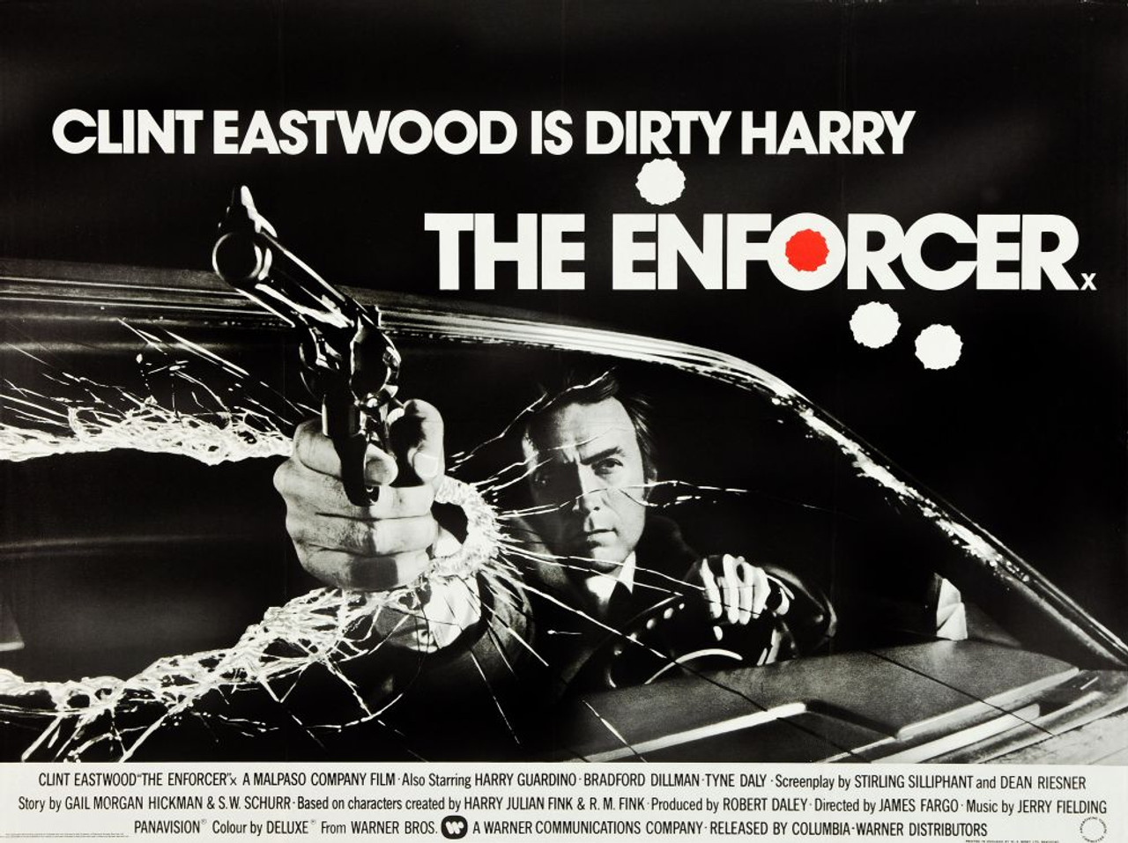
Purpose Trusts (continued)
New position:
Enforcer

Slide 13
Purpose Trusts (continued)
An Enforcer is:
Not a new concept but a newly recognized office, presumed to be a fiduciary position, unless trust states otherwise;
May be appointed by the Court if trust lacks an office of enforcer or the office is vacant;
A person with an interest in declared purpose of trust may petition court to appoint an enforcer or to remove an enforcer;

Slide 14
Purpose Trust (continued)
An Enforcer is:
Authorized to, and has standing to, enforce the trust (but the trust may appoint others to enforce the trust)
May effect trust modification under Delaware modification statutes if the trust lacks an identifiable person as beneficiary:
  Enforcer is an “interested person” under 12 Del. C. § 3338
  Each enforcer then serving must consent or nonobject under 12 Del. C. §3342

Slide 15
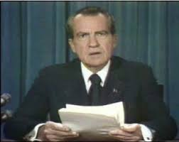
Resignation of Officeholders
(Section 3326)

Slide 16
Resignation of Officeholders– cont’d
3326 previously said resignations are:
Per instrument
If instrument silent but includes appointment provisions, then on 30 days notice to beneficiaries, those holding power to appoint successors, and any other officeholders
“In all other cases, with the approval of the Court of Chancery.”
But 3338(e)(4) says NJSAs may resolve “[t]he resignation, removal, or appointment of a trustee and the determination of a trustee’s compensation.”

Slide 17
Resignation of Officeholders– cont’d
Harmonizing 3326 and 3338 by amending 3326. The new hierarchy for resignations is:
Per instrument
If instrument silent but includes appointment provisions, then on 30 days notice to beneficiaries, those holding power to appoint successors, and any other officeholders
Even if the 2 previous routes are available, under a 3342 modification (because the grantor would be living)
If none of the 3 previous routes are available, per an NJSA under 3338.
“In all other cases, with the approval of the Court of Chancery.”

Slide 18

Gifts Between Spouses (Title 13, section 1513)
Outright gifts between spouses is not excluded as marital property, meaning that it might be included as marital property;
Property held in trust for one spouse, which was gifted by the other, is not marital property unless the trust states otherwise.

Slide 19

Statutory Amendments regarding Parentage and Related Topics
(not in TA 2025 – separate legislation)
This Photo by Unknown Author is licensed under CC BY-SA-NC

Slide 20
Intestacy - Child – Parent - Issue
Intestacy with no parents or issue – passes to “issue of decedent’s parent…” 12 Del. C. §503.
Definition of child and parent are in Uniform Parentage Act.
If a parent dies with a will that omits a child born after will execution date, such after-born child and now such child’s own issue can take under the will. 12 Del. C. §301.
Another intestacy improvement forces an intestate heir to choose line of relationship if more than one exists so as to inherit only once by intestacy. 12 Del. C. §503(c).

Slide 21
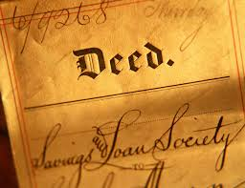
Transfer on Death Deeds
(not in TA 2025 – separate legislation)

Slide 22
TOD Deeds
    Effective 90 days from enactment (signed Sept. 5, 2025, so effective Dec. 4, 2025)
    Affects subjects of many different Delaware Code titles – not just Title 25 (Property), but also Titles 12 (Trusts & Estates), 18 (Insurance), and 30 (Taxes)

Slide 23

TOD Deeds (cont’d)
    Revocable no matter what the document provides

Slide 24
TOD Deeds are “nontestamentary” – but note:
    Must be witnessed by 2 witnesses, one of whom can’t be a beneficiary
    The real property is still subject to creditor claims if probate estate insufficient – but such liability must be enforced within 8 months of decedent’s death
    There are various Register of Wills procedures that may come into play (see outline for more details)

Slide 25
TOD Deeds (cont’d) –
Other features
    A TOD deed doesn’t require notice/acceptance/delivery by the beneficiary during the owner’s life, and also doesn’t require consideration
    A TOD deed inherently has no title covenants or warranties no matter what the instrument might otherwise indicate

Slide 26
TOD Deeds (cont’d) –
Professionals should note:
    Estate Planning: if you firm/company will include these as part of the planning process, make sure your firm/company has both real estate and estate planning professionals who really know what they’re doing in this field.
    Estate Administration: yet another reason to require (as a routine part of estate administration) getting a title and lien search as to the decedent and any real property the decedent owned at death.

Slide 27

Case law updates involving Delaware trusts
(Oct. 2024-Oct. 2025)

Slide 28


Eicoff - actions in both Delaware and Florida
(no-contest clause enforced in Delaware)

Slide 29

CES 2007 Trust – DAPT case
(DAPT statute upheld, BUT THEN….)

Slide 30
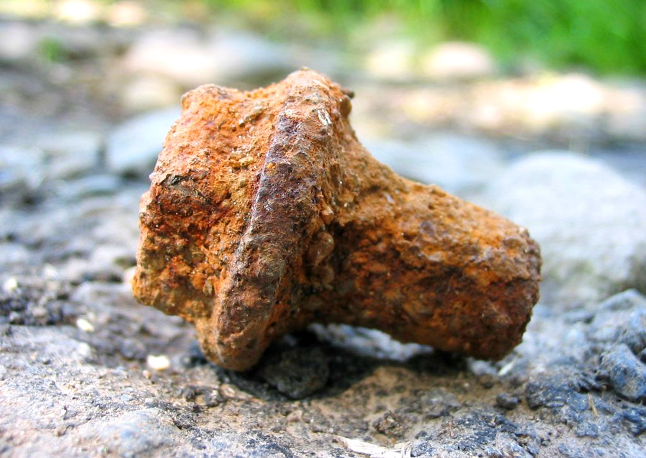

Rust v. Rust (2 decisions)
(Claims against trustee dismissed)

Slide 31

Burd v. Elliman
(pre-mortem validation decision after trial)

Slide 32

Some Case Law Themes for 2024-2025
Theme One: The Vexatious Litigant vs. the Elder Abuser
Tools to prevent vexatious litigation:
No-contest clauses (Eicoff; Kelley v. Procino)
Pre-mortem validation (Burd)
Tools to prevent elder abuse:
Melson factors to prove undue influence (Burd; Kelley v. Procino)
Lifetime guardianships
Accountings – not the right time (Solberg)

Slide 33

Some Case Law Themes for 2024-2025, cont’d
Theme Two: Dos and Don’ts of Estate Accountings
Do keep records and submit receipts of estate expenditures (Solberg)
Don’t miss filing deadlines (Kennedy)
Don’t charge attorney fees to one sibling who hired an attorney to assist (Kennedy)
Best practice is to keep track of time spent by Personal Representative ($60 - $70/hr. is ok)
Some leniency is permitted: no need to list “every scrap of garbage” (Solberg)

Slide 34
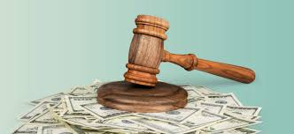
Some Case Law Themes for 2024-2025, cont’d
Theme Three: Fee and Cost Shifting Rules Upheld
High bar to shift attorneys’ fees (Grooms, Kelley, Burd)
Costs are shifted to losing party (Grooms)

Slide 35

Some Case Law Themes for 2024-2025, cont’d
Theme Four: Oral Contract to Make a Will
Very hard to prove (Kalisty; Buck v. McCaffery)
Escheat? (See Kalisty)

Slide 36

Some Case Law Themes for 2024-2025, cont’d
Theme Five: One-Hit (case law) Wonders
When is a gift complete/deathbed gifts (Solberg)
Laches after 40 years? (Hall v. Mundy)
Ouster (Campo)
Guardianship real estate (J.H.C. III case)

Slide 37
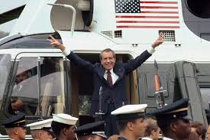
Thank you!
Jocelyn Borowsky
Greg Weinig

